Slide 1

CHAPTER 5 Management of archives repositories

Slide 2
Content
1.0: Intellectual control
2.0: Physical control
3.0: Finding aids

Slide 3
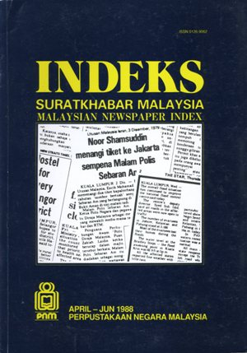
1.0: Intellectual Control
Intellectual Control:
The creation of tools such as such as inventory, thematic guide, catalogue, and COMPASS (Computerized Archival System and Services) are designed to assist researchers to find their required materials.
provides a means of identifying potentially relevant materials, with a pointer to where those materials are stored; identifies for users what materials are held, what subjects they deal with and where they are located
Intellectual control done by arrangement & description. It is gained through:
Completed inventory and location guide
Created/recovered accession records
Creating finding aids

Slide 4
2.0: Physical Control
Physical Control:
Determine the way of storing archival materials: establishing order (arrangement) within series, re-housing material, separation of special formats
The function of tracking the storage of records to ensures that the records are pointer specifies; ensures that all series and items are accounted for in the repository and can be found and use
For instances: pointing to a specific box on a specific shelf in a specific room.

Slide 5
3.0 Finding Aids
Define as a document, published or unpublished, listing or describing a body of records or archives. Guide which leads archivists and researchers to information they are seeking
Authenticate and document collection tools for repository.
Information discovery and retrieval tool; maybe print or electronic.
Examples of finding aids:
Databases,
indexes,
calendars,
guides,
inventories,
shelf and container lists, and
registers

Slide 6
A purposes/tool that facilitates discovery of information within a collection of records:
provide an essential link between archives and their users.
assist archivists and users in finding the records they need.
assist in the retrieval of information contained in archival holdings and
facilitate efficient management of the repository.

Slide 7
There are three common types of finding aids:
Repository guide
guide to the holdings
Descriptive inventory
gives the basic information about a collection; contain descriptions of all Record Groups and Sub-Groups as well as content descriptions of box numbers and a list of their contents.
Summary inventory
describes the materials and all items included in holdings (a comprehensive listing of the materials that are within the collection)

Slide 8
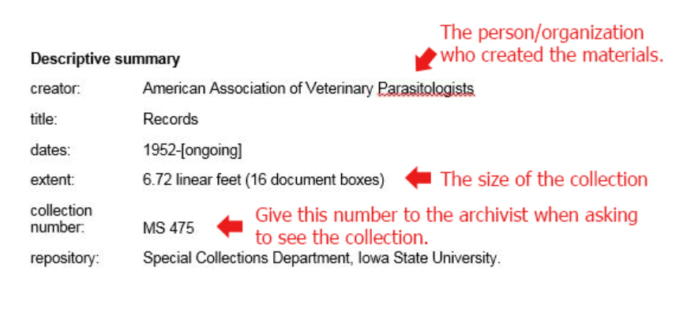
Samples Descriptive Inventory
Notes: a title, the name of the person who created the materials, the dates of the collection, the extent, the reference code, and the repository where the collection is located.

Slide 9
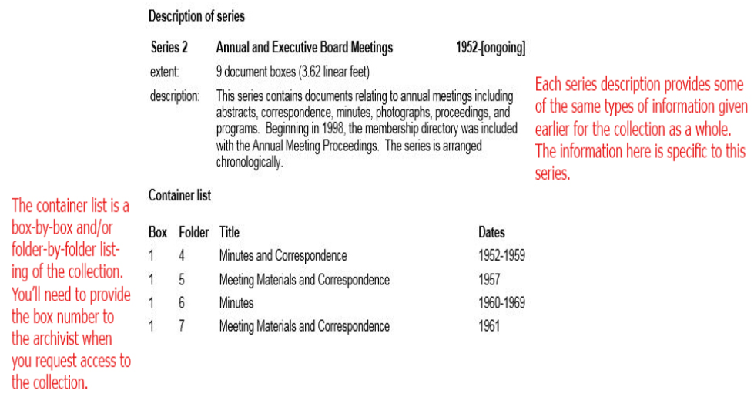
Samples Summary Inventory
Notes: If the collection is arranged in series, the container list will indicate which boxes and folders are found in which series. Each series may also have its own content description, dates, and arrangement

Slide 10
Each finding aids details should consist of:
Administrative history
Administrative histories and contextual information to help readers to understand the significance of the archives.
Series description
- Group code - First and last date
- Series number - Number of items
- Series title - Physical nature
Description of documents
- Subject
- Function
- Summary
- Significant information from custodial history
- Directly related series

Slide 11
The function of a finding aids:
To arrange the materials in their original structural order
By writing down the essential descriptive facts about the originals, the archivist are able to create a set of representations, which can in a way stand in for the original.
To provide access point.
To provide physical control and intellectual control of the archival materials.

Slide 12
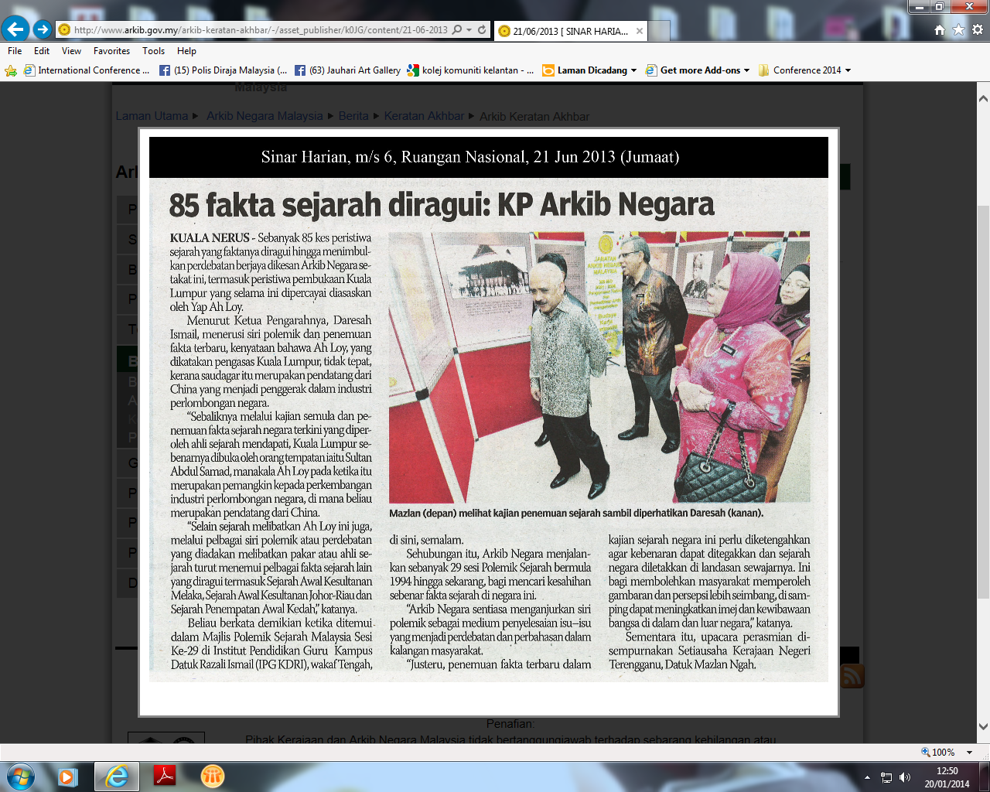
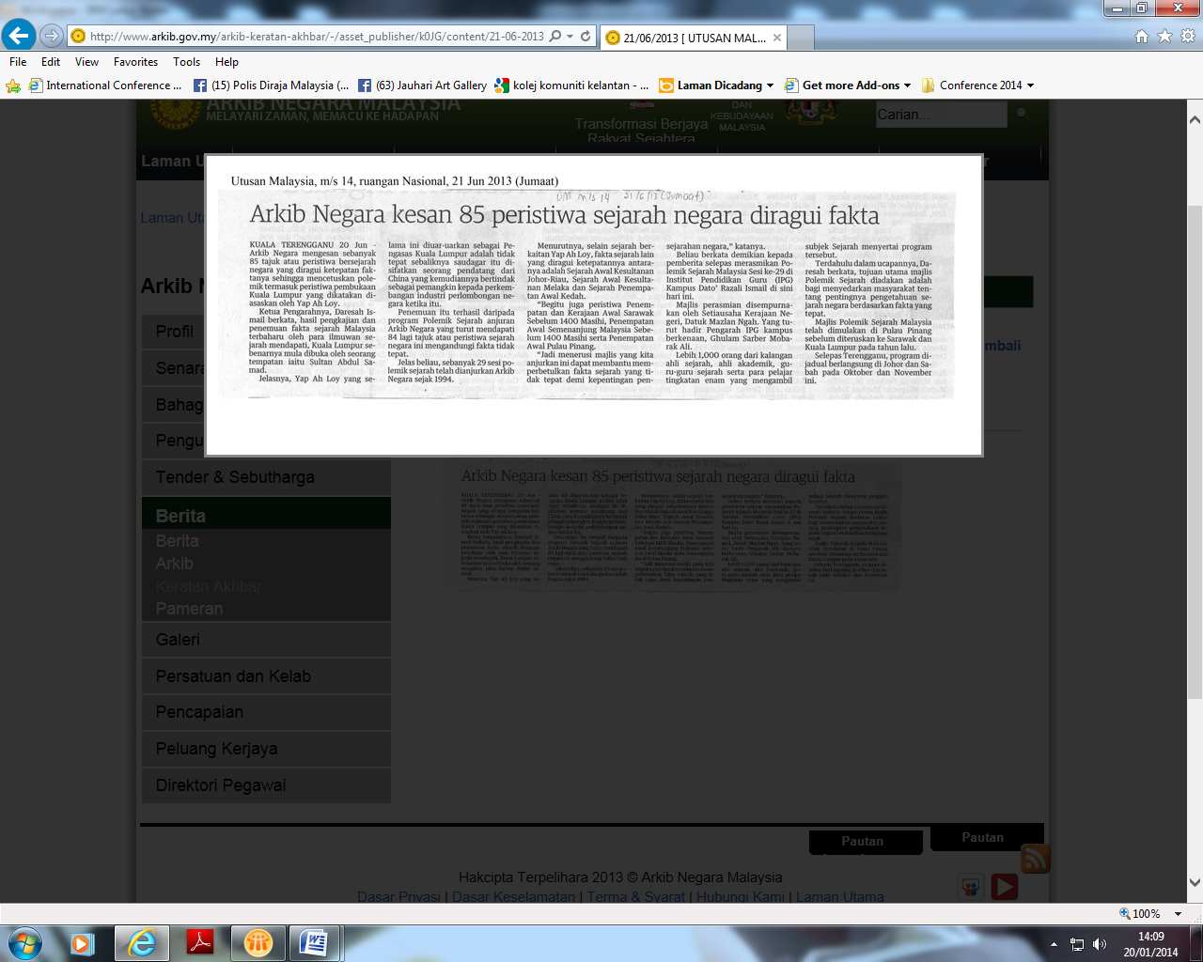
Finding aid system consist the following elements:
A principal documentation containing descriptions in structural order
Secondary representation documentation for administrative control
Secondary representation documentation in subject order.
Retrieval aids such as user guides and indexes.

Slide 13
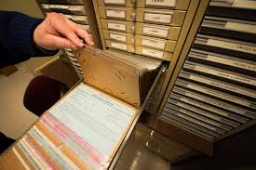
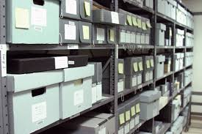
Copies of the finding aids:
list where the collection is located and it may be accessed:
Two copies at least in the reference area (one for research use and one for staff use).
One in the editorial area (For future revision)
One in the storage area.
One in regional area.
One with the director of the archival institution.

Slide 14
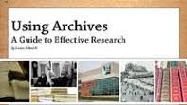
THANK YOU
Thank You

